Slide 1
ESE_4009 Embedded Systems Design Project
Task 1: Ordering Hardware Components
Submitted To: Prof. Mike Alesham
Submitted by: Sukhmeet Sidhu (C0751457)

Slide 2
Overview
Task 1 is based on finalizing hardware components and orderining through different online portals or local stores.
This project is called IOT Enabled Beaglebone based smart parking system with SMS alert.

Slide 3
List Of Hardware Components
Beaglebone Black
Ultrasonic sensors
RFID
WiFi module
Gsm Module
Servo motor
Buzzer
Voltage Regulator
Adapter
Soldering Iron Kit with Multimeter
Jumper wires and Bread Board

Slide 4
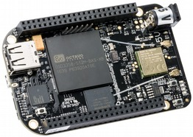
Beaglebone Black Rev C
It will be used as the main microcontroller. Box also includes a miniUSB to USB Type A cable. It is low cost, compact board used to build complex applications.
It is designed to fulfill requirements in fields such as gaming devicies, home and industrial automation, consumer medical and intelligent machines and many more.

Slide 5
BeagleBone Compatibility
Changed eMMC from 2GB to 4GB
512MB DDR3L for cost reduction, Performance boost and lower power
No serial port by default to reduce cost.
No JTAG emulation over USB for cost reduction.
EEPROM Reduced from 32KB to 4KB
Power expansion header removed for cost reduction.
HDMI interface onboard for audio and video capablility
No Three function USB cable for cost reduction.
512MB DDR3L,4KB EEPROM,4GB Embedded MMC and MicroSD Connector memory found on board.

Slide 6
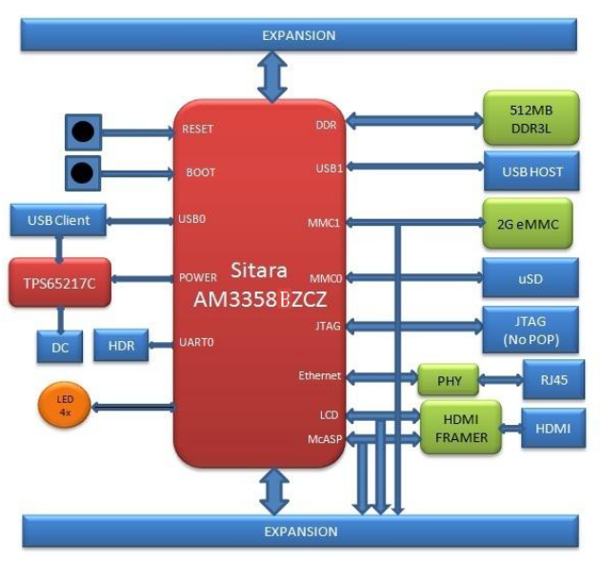
Block Diagram

Slide 7
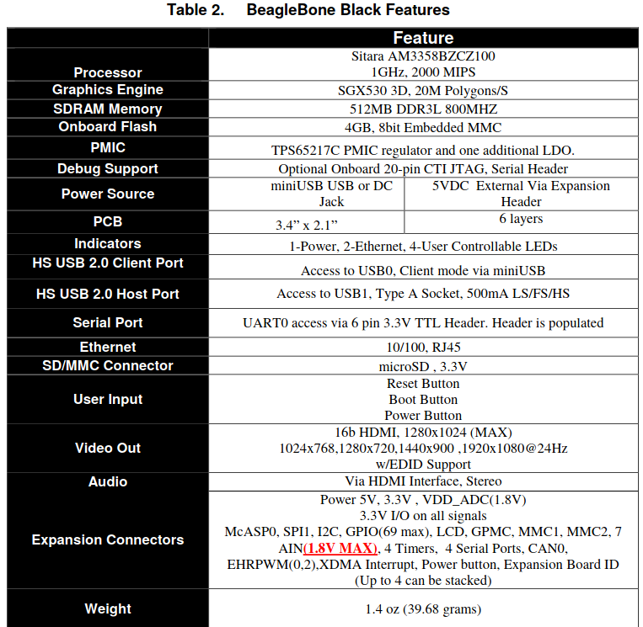
Features And Specifications

Slide 8
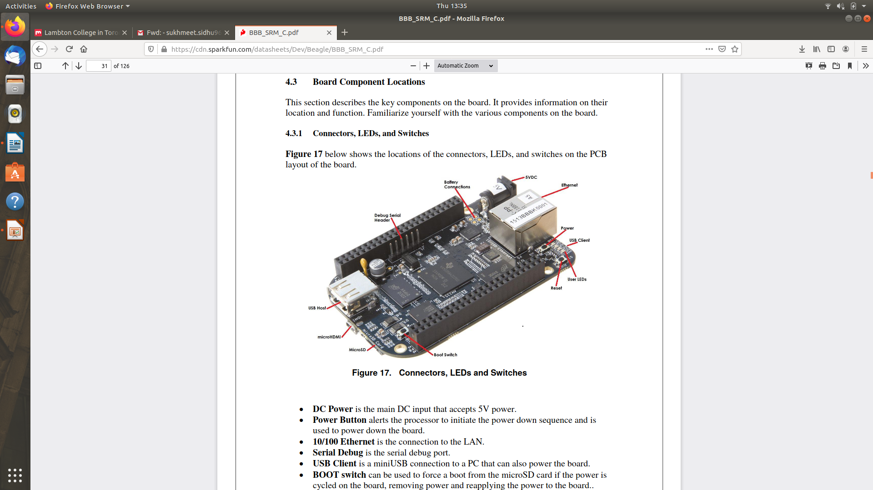
1.DC power is th emain DC input that accepts 5V power.
2.Power Button alerts the processor to initiate the power down the sequence and is used to pwer down the board.
3.10/100 Ethernet is the connection to LAN.
4.Serial Debug is the serial Debug port.
5.Usb Client is a miniUSB connection to a PC that can also power the board.
6.BOOT switch can be used to force a boot from the microSD card if the power is cycled on the board, removing power and reapplying the power to the board.
7.There are four blue LEDS that can be used by the user.
8.Reset Button allows the user to reset the processor.
9.MicroSD slot is where a microSD card can be installed.
10.MicroHDMI connector is where the display is connected to.
11.USB Host can connected different USB interfaces such as Wi-Fi,BT, Keyboards, etc.

Slide 9
Key Components
Sitara AM3358BZCZ100 is the processor for the board
Micron 512MB DDR3L is the dual data rate RAM memory
TPS65217C PMIC provides the power rails to the various components
SMSC Ethernet PHY is the physical interface of the network
Micron eMMC is an onboard MMC chip that holds upto 4GB of data.
HDMI framer provides control for an HDMI with an adapter.

Slide 10
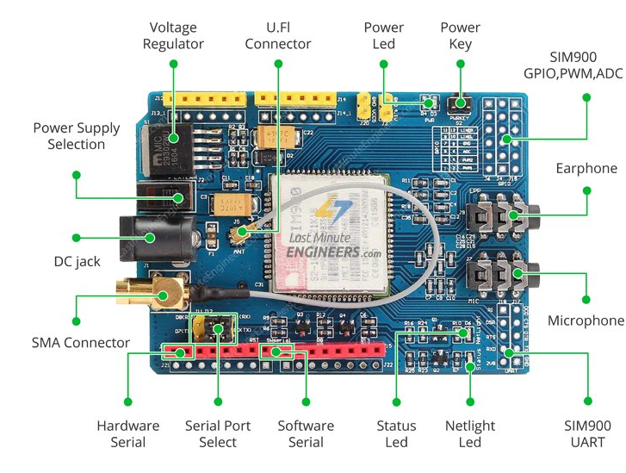
GSM Module-SIM900

Slide 11
SIM900 GSM/GPRS shield is a GSM modem, which can be integrated into a great number of IoT projects. You can use this shield to accomplish almost anything a normal cell phone can; SMS text messages, Make or receive phone calls, connecting to internet through GPRS, TCP/IP, and more! To top it off, the shield supports quad-band GSM/GPRS network.
The SIM900 GSM/GPRS shield uses UART protocol to communicate with an Arduino

Slide 12
Specifications
Supports Quad-band: GSM850, EGSM900, DCS1800 and PCS1900
Connect onto any global GSM network with any 2G SIM
Make and receive voice calls using an external earphone & electret microphone
Send and receive SMS messages
Send and receive GPRS data (TCP/IP, HTTP, etc.)
Scan and receive FM radio broadcasts
Transmit Power:
Class 4 (2W) for GSM850
Class 1 (1W) for DCS1800
Serial-based AT Command Set
U.FL and SMA connectors for cell antenna
Accepts Full-size SIM Card

Slide 13
LED Status Indicators-There are three LEDs on the SIM900 GSM/GPRS shield which indicates connectivity or power status.
PWR: This LED is connected to the shield’s power supply line. If this LED is on, the shield is receiving power.
Status: This LED indicates SIM900’s working status. If this LED is on, the chip is in working mode.
Netlight: This LED indicates the status of your cellular network. It’ll blink at various rates to show what state it’s in.
off: The SIM900 chip is not running
64ms on, 800ms off: The SIM900 chip is running but not registered to the cellular network yet.
64ms on, 3 seconds off: The SIM900 chip is registered to the cellular network & can send/receive voice and SMS.
64ms on, 300ms off: The GPRS data connection you requested is active.

Slide 14
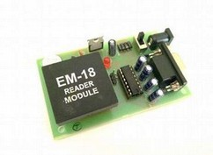
RFID Reader
Radio frequency Identification (RFID) is a wireless identification technology that uses radio waves to identify the presence of RFID tags.
Just like Bar code reader, RFID technology is used for identification of people, object etc. presence.
In RFID technology we just need to bring RFID tags in range of readers. Also, barcodes can get damaged or unreadable, which is not in the case for most of the RFID.
RFID is used in many applications like attendance system in which every person will have their separate RFID tag which will help identify person and their attendance.
RFID is used in many companies to provide access to their authorized employees.
It is also helpful to keep track of goods and in automated toll collection system on highway by embedding Tag (having unique ID) on them.

Slide 15
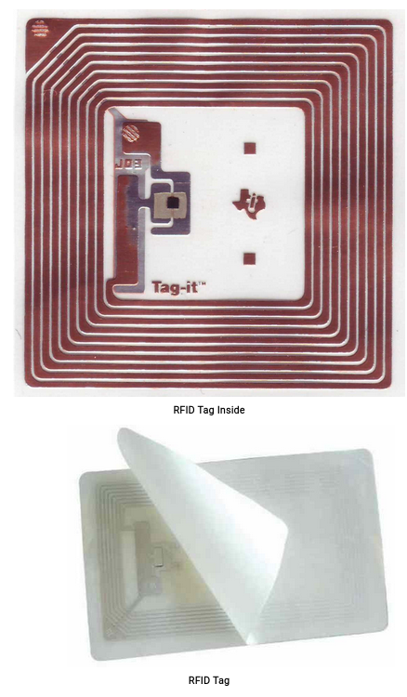
RFID TAG
RFID tag includes microchip with radio antenna mounted on substrate which carries 12 Byte unique Identification number.

Slide 16
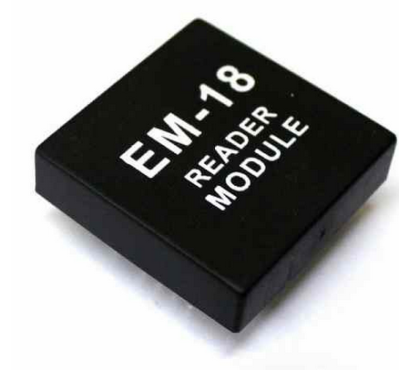
RFID Reader
It is used to read unique ID from RFID tags. Whenever RFID tags comes in range, RFID reader reads its unique ID and transmits it serially to the microcontroller or PC. RFID reader has transceiver and an antenna mounted on it. It is mostly fixed in stationary position.
There are 3 types of RFID Readers:- Active, Passive and active-passive Redaers.

Slide 17
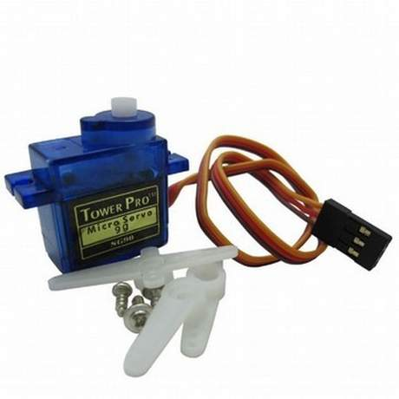
Servo Motor-SG90
Operating Voltage is +5V typically
Torque: 2.5kg/cm
Operating speed is 0.1s/60°
Gear Type: Plastic
Rotation : 0°-180°
Weight of motor : 9gm
Package includes gear horns and screws
Used as actuators in many robots like Biped Robot, Hexapod, robotic arm etc..
Commonly used for steering system in RC toys
Robots where position control is required without feedback
Less weight hence used in multi DOF robots like humanoid robots

Slide 18
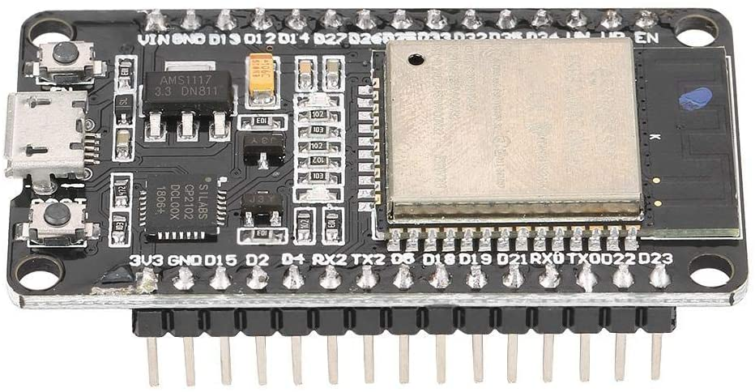
WiFi Module

Slide 19
WIFI Module ESP32
The ESP32 is design for low power IoT applications in mind. It’s high processing power with in-built Wi-Fi / Bluetooth and Deep Sleep Operating capabilities makes it ideal for most Portable IoT devices
3 ways to power module:
Micro USB Jack: Connect the mini USB jack to a phone charger or computer through a cable and it will draw power required for the board to function
5V Pin: The 5V pin can be supplied with a Regulated 5V, this voltage will again be regulated to 3.3V through the on-board voltage regulator. Remember ESP32 operated with 3.3V only.
3.3V Pin: If you have a regulated 3.3V supply then you can directly provide this to the 3.3V pin of the ESP32.

Slide 20
Pin Category | Pin Name | Details
Power | Micro-USB,3.3V,5V,GND | Micro-Usb-ESP32 can be powered through USB port 5V: Regulated 5V can be supplied to this pin which is again regualted to 3.3V by on board regulator, to power the board. 3.3V: Regulated 3.3V can be supplied to this pin power the board. GND: Ground pins.
Enable | En | The pin and the button resets the microcontroller.
Analog Pins | ADC1_0 to ADC1_5 and ADC2_0 to ADC2_9 | Used to measure analog voltage in the range of 0-3.3V 12-bit 18 Channel ADC
DAC Pins | DAC1 and DAC2 | Used tfor digital to analog conversion
Inputs/Output Pins | GPIO0 to GPIO39 | Totally 39 GPIO pins can be used as input or output pins. 0V (low) and 3.3V(high). But pins 34 to 39 can be used as input only
Capacitive Touch pins | T0-T9 | These 10 pins can be used a touch pins normally used for capacitive pads.
Serial | Rx, Tx | Used to receive and transit TTL serial Data.

Slide 21
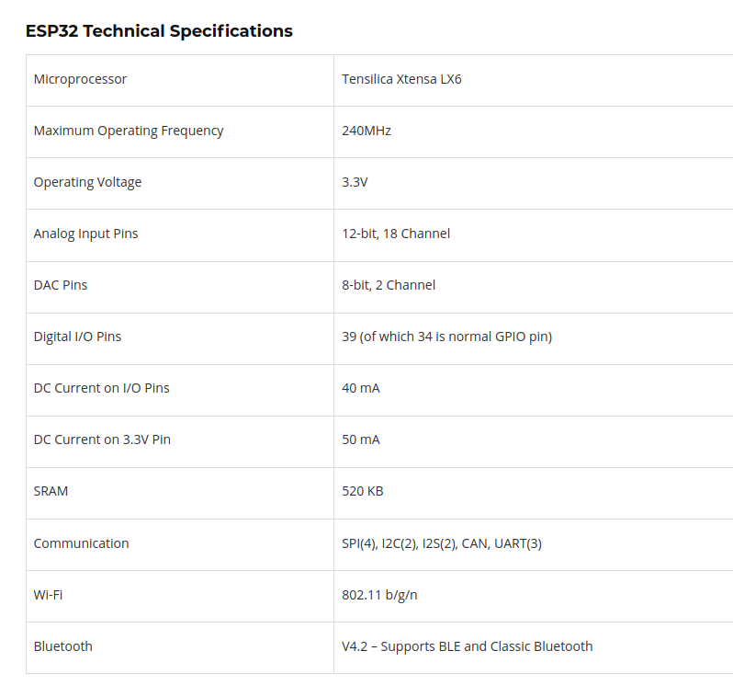

Slide 22
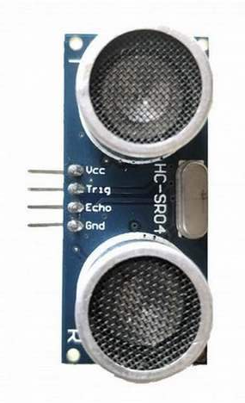
Ultra Sonic Sensor-HCSR04
HC-SR04 ultrasonic distance sensor.
This economical sensor provides 2cm to 400cm of non-contact measurement functionality with a ranging accuracy that can reach up to 3mm.
It includes a transmitter, receiver and a control circuits.
4 PINS: VCC(Power), Trigger, Echo(Receive), and GND (Ground)
An additional control circuitry prevents inconsistent “bouncy” data.
The basic principle of work:
1. Using IO trigger for at least 10us high level signal
2. The Module automatically sends eight 40 kHz and detect whether there is a pulse signal back.
3. IF the signal back, through high level , time of high output IO duration is the time from sending ultrasonic to returning.
Test distance = (high level time×velocity of sound (340M/S) / 2,

Slide 23
Electric Parameter
Working Voltage- DC 5v
Working current- 15mA
Working frequency- 40Hz
Max range- 4m
Min range- 2cm
Measuring angle-15 degree
Trigger input signal-10uS TTL pulse
Dimensions- 45*20*15mm

Slide 24
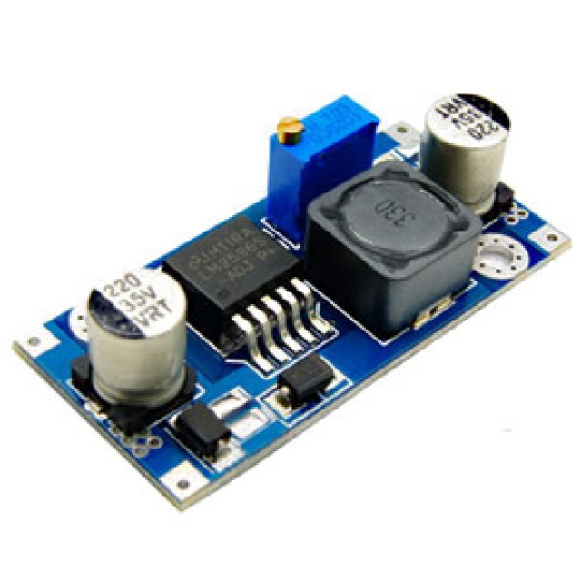
Volatge Regulator-LM2596
A voltage regulator is a system designed to automatically maintain a constant voltage level. A voltage regulator may use a simple feed-forward design or may include negative feedback. It may use an electromechanical mechanism, or electronic components.

Slide 25
Regulator Type | Step Down (Non Isolated input to Output)
Input Voltage | +4 to 40vdc
Output Voltage | +1.23 to 35 vdc
Output Current | 2A Rated, ( 3A maximum with heat sink)
Switching Frequency | 150kHz
Efficency | Up to 92% ( when output voltage is set high)
Dropout Voltage | 2vdc minimum
Load Regulation | +/- 0.5%
Volatge regulation | +/- 2.5%
Temerature | -40c to +85 deg C

Slide 26
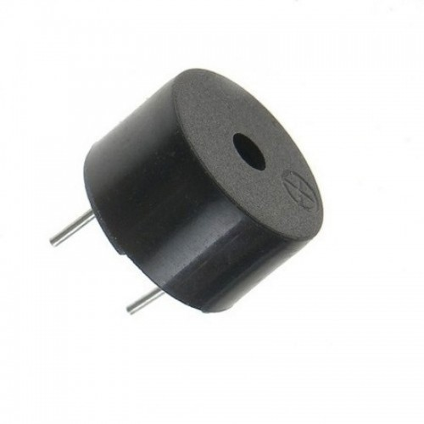
Buzzer
A buzzer or beeper is an audio signalling device, which may be mechanical, electromechanical, or piezoelectric (piezo for short).
Typical uses of buzzers and beepers include alarm devices, timers, and confirmation of user input such as a mouse click or keystroke.

Slide 27
Specifications
Color: Black
Driver Circuitry: Transducer
Input Type: Zero-Peak Signal
Frequency: 2Khz
Technology: Piezo
Operating Mode: Ringer
Sound Pressure Level: 70 db@1.5v
Operating Temperature:-20c-70c
Mounting type: Through hole

Slide 28
Supporting Hardware
Soldering Kit and multimeter-handskit Soldering Iron Kit, Soldering Iron, 60w 110v Soldering Equipment with Adjustable Temperature Welding Tool and 5pcs Iron Tips, Solder Sucker, Soldering Iron Stand, Solder Wire, Tweezer
Adapter- An adapter or adaptor is a device that converts attributes of one electrical device or system to those of an otherwise incompatible device or system
Jumper wires and PCB boards.

Slide 29
References
https://cdn.sparkfun.com/datasheets/Dev/Beagle/BBB_SRM_C.pdf
https://www.sparkfun.com/products/15569
https://cdn.sparkfun.com/datasheets/Sensors/Proximity/HCSR04.pdf
https://www.digikey.at/product-detail/en/murata-electronics/PKM22EPPH2001-B0/490-4691-ND/1219322
https://components101.com/microcontrollers/esp32-devkitc
https://lastminuteengineers.com/sim900-gsm-shield-arduino-tutorial/
https://www.minikits.com.au/LM2596-PSU-01
https://components101.com/servo-motor-basics-pinout-datasheet
https://components101.com/servo-motor-basics-pinout-datasheet

